Slide 1
Why WhiteboardDAO?

Slide 2

What is WhiteboardDAO?
Open initiative
Periodically host whiteboard sessions
Research hard problems in crypto
Can evolve into more
Anyone is free to propose an initiative

Slide 3

…. Because it is hard
For the challenge of it
For the impact
Encourage non-”experts” to understand and attempt tackling hard problems

Slide 4

Why not for-profit?
More open and collaborative
Unbiased
Explore multiple design choices without locking into one
Research that doesn’t immediately lead to a profitable venture

Slide 5
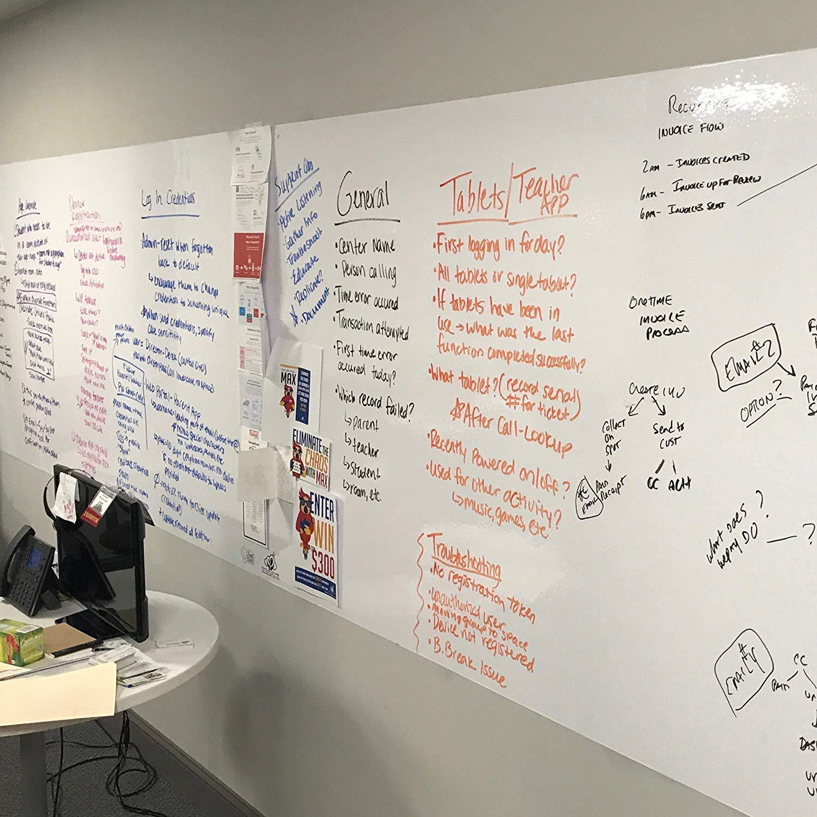
Why whiteboards?
Start from first principles
Fresh eyes + fresh ideas
Reason through multiple lines of thought
Balance between constrained and unconstrained

